Slide 1



UNIT 4
LESSON 16
What if…?
Part 4

Slide 2
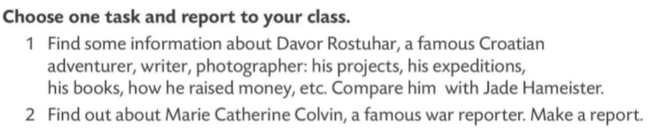
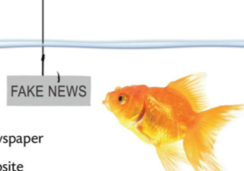
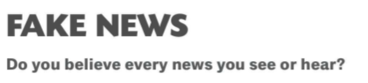
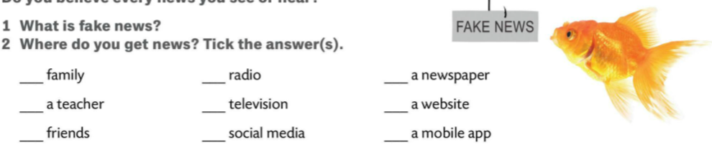
Start with the reports prepared for homework.
FAKE NEWS
false stories that appear to be news, spread on the internet or using other media, usually created to influence political views or as a joke

Slide 3
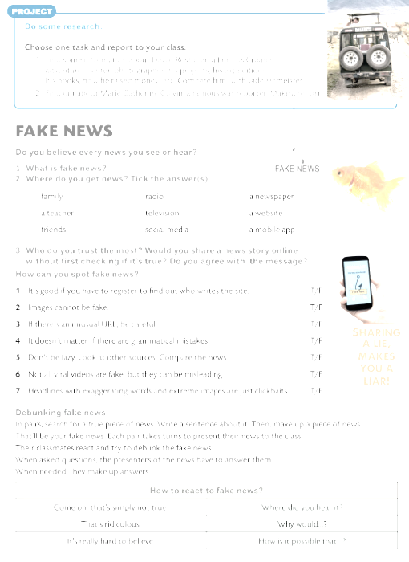
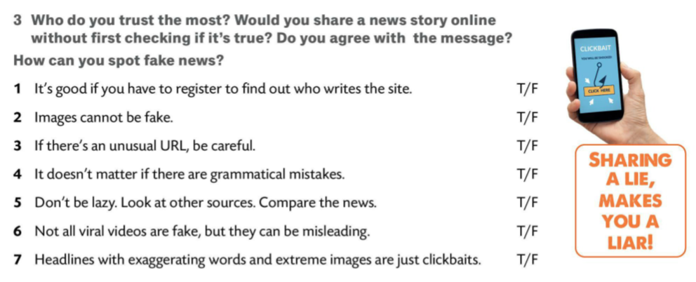
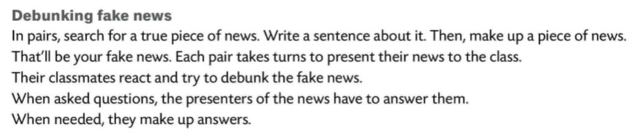
to debunk
to show that something is less important, less good, or less true than it has been made to appear
razotkriti

Slide 4
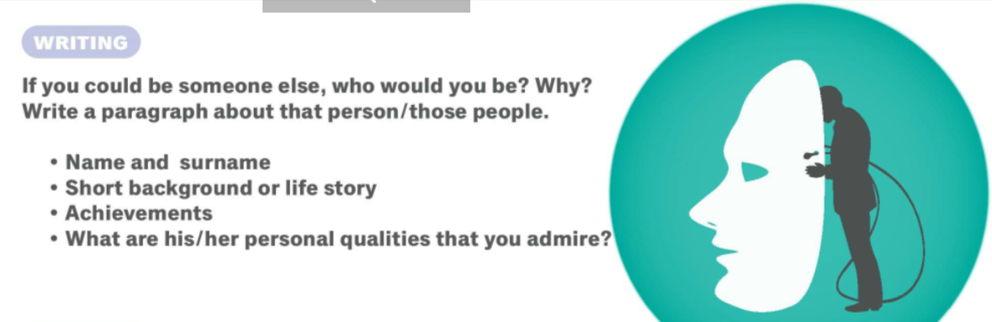
Exchange your paragraphs so you can do some peer feedback.

